Slide 1



Java basics
Session
3
Chaim Turkel
Ido Barash

Slide 2


Last session
Inheritance
Interfaces
Interface VS Abstract class
casting
Polymorphism

Slide 3
Java basics - 3
Exceptions
Collections interfaces
Iterators

Slide 4
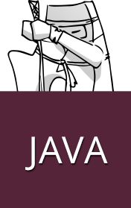
Exceptions
Exception: a irregular behavior that arises during the execution of a program.
Mostly used to handle errors.
Errors can occur due to many reasons
User error
Program error
Physical resources error

Slide 5
Exceptions
Checked exceptions: exceptional scenarios that can be anticipated and maybe recovered from. Has to be handled at compile time. For example: FileNotFoundException
Unchecked exceptions: Runtime exceptions that mostly can be avoiding at programming time. For example: ArrayOutOfBoundException
Errors: problems that arise beyond our control – mostly ignored.

Slide 6







Exceptions
Exceptions hierarchy:
Throwable
Error
Exception
OutOfMemory Error
IOError
IOException
RunTimeException
FileNotFoundExceptions

Slide 7
Exceptions
Exceptions hierarchy:
Throwable
Error
Exception
OutOfMemory Error
IOError
IOException
RunTimeException
FileNotFoundExceptions
Checked exceptions

Slide 8
Exceptions
Exceptions hierarchy:
Throwable
Error
Exception
OutOfMemory Error
IOError
IOException
RunTimeException
FileNotFoundExceptions
unchecked exceptions

Slide 9
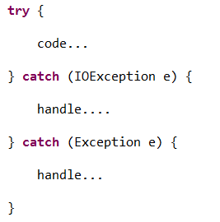
Exceptions
Catch an exception: every Throwable can be caught.
If a method does not handle checked exception it must declare it using the “throws” keyword

Slide 10
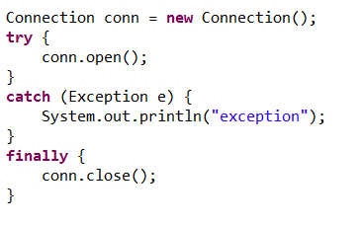
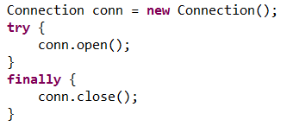
Exceptions
Finally block contains code that will be executed after the executing of the “try” block or the end of the “catch” block.
Finally block will always be executed.
Catch block is not required if you don’t need it.

Slide 11
Exceptions - questions
What is the base class for Error and Exception?
What is the difference between Error and Exception?
If I write return statement in the “try” block, will “finally” block still execute?

Slide 12
Exceptions - questions
What is the base class for Error and Exception?
What is the difference between Error and Exception?
If I write return statement in the “try” block, will “finally” block still execute?
Throwable class

Slide 13
Exceptions - questions
What is the base class for Error and Exception?
What is the difference between Error and Exception?
If I write return statement in the “try” block, will “finally” block still execute?
Throwable class
Error is an irrecoverable situation that occurred during runtime. An exception is a situation you might be able to recover from.

Slide 14
Exceptions - questions
What is the base class for Error and Exception?
What is the difference between Error and Exception?
If I write return statement in the “try” block, will “finally” block still execute?
Throwable class
Error is an irrecoverable situation that occurred during runtime. An exception is a situation you might be able to recover from.
Yes. The finally block will be executed and then the value will be returned.

Slide 15
Collections API
Java provide a nice API to simplify the work with collection of objects.
The Collection API contain a set of classes and interfaces with well defined methods to handle collections of objects.
Basically, These are Java out-of-the-box implementations to known data structures, such as: List, Set, Map, Tree etc…
All collections has no fixed size

Slide 16

Collections API
Java.util.Collection interface
Basic operations:
Entire collection operations :

Slide 17


Collections API
Java.util.List interface
A subtype of the Collection interface
Represents an ordered list objects
Adds the following functionality:
Some implementations:

Slide 18



Collections API
Java.util.Set interface
A subtype of the Collection interface
Represents a collection of object with no duplicates.
Some implementations:

Slide 19
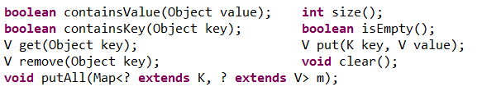

Collection API
Java.util.Map interface
NOT A subtype of the Collection interface
Represents a map between a key and a value
Has the following functionality:
Some implementations:

Slide 20
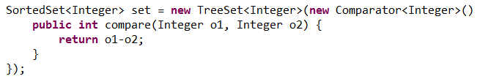
Collections API
Java.util.SortedSet interface
A subtype of the Set interface
Represents an ordered collection of objects with no duplicates.
Uses a class that implements Comparator interface to decide order.
If no Comparator was provided, items are expected to implement Comparable interface.

Slide 21

Collections API
Java.util.Queue interface
A subtype of the Collection interface
Represents an ordered list of object but it allows to add elements only to the end of the list, and removing element only from the beginning of the list.
Adds the following functionality:

Slide 22
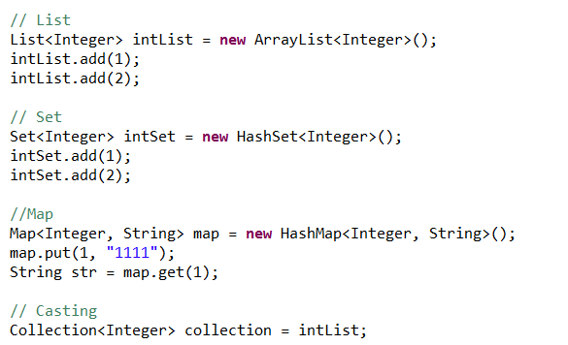
Collections API
Examples:

Slide 23
Iterator
An Object the implements either the Iterator interface or the ListIterator Interface.
Iterator can traverse through a collection, obtain or remove elements.
ListIterator extends the Iterator by allowing bi-directional traversing on a collection.
Every collection implementation must provide an iterator for this collection.

Slide 24

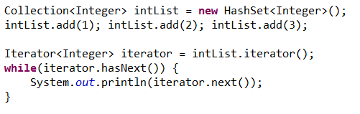
Iterator
The iterator interface provide the following methods:
Using an iterator:

Slide 25

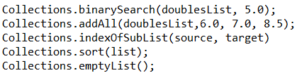
Utility classes
Java provides two useful utility classes to work with collections.
Arrays: Contains static methods to use on arrays:
Collections: Contains static methods to use on collections:

Slide 26
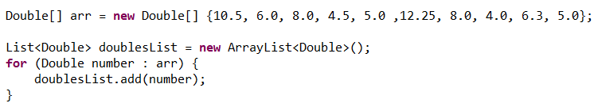
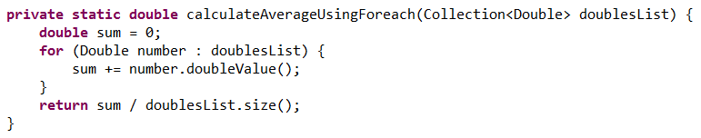
Collections and Iterator
Ex: Create a collection of double items and insert these numbers: 10.5, 6, 8, 4.5, 5,12.25, 8, 4, 6.3, 5 for your convenience:
Write a function to calculate average using for each

Slide 27
Collections and Iterator
Ex: Create a collection of double items and insert these numbers: 10.5, 6, 8, 4.5, 5,12.25, 8, 4, 6.3, 5 for your convenience:
Write a function to calculate average using for each

Slide 28
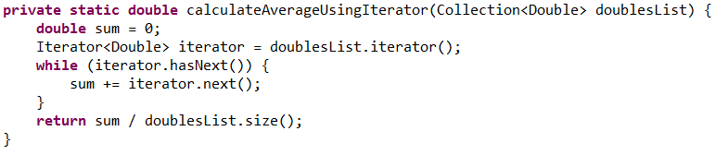
Collections and Iterator
Ex: Create a collection of double items and insert these numbers: 10.5, 6, 8, 4.5, 5,12.25, 8, 4, 6.3, 5 for your convenience:
Write a function to calculate average using iterator

Slide 29
Collections and Iterator
Ex: Create a collection of double items and insert these numbers: 10.5, 6, 8, 4.5, 5,12.25, 8, 4, 6.3, 5 for your convenience:
Write a function to calculate average using iterator

Slide 30
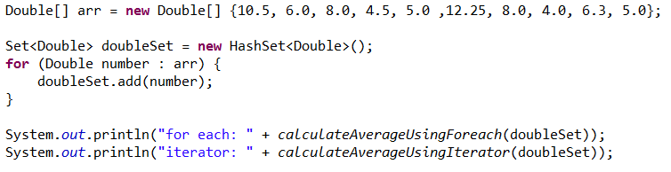
Collections and Iterator
Ex: Create a collection of double items and insert these numbers: 10.5, 6, 8, 4.5, 5,12.25, 8, 4, 6.3, 5
Change the code so every number will be added to the sum only once (do not change methods)

Slide 31
Collections and Iterator
Ex: Create a collection of double items and insert these numbers: 10.5, 6, 8, 4.5, 5,12.25, 8, 4, 6.3, 5
Change the code so every number will be added to the sum only once (do not change methods)

Slide 32
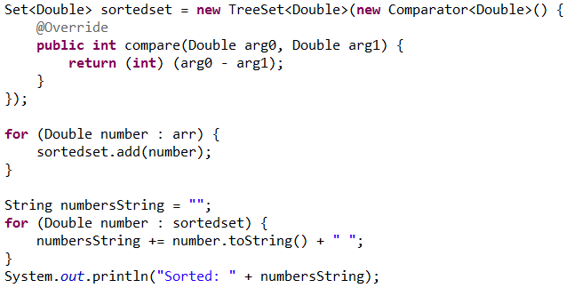
Collections and Iterator
Ex: Create a collection of double items and insert these numbers: 10.5, 6, 8, 4.5, 5,12.25, 8, 4, 6.3, 5
Print the List sorted and without duplicates:

Slide 33
Collections and Iterator
Ex: Create a collection of double items and insert these numbers: 10.5, 6, 8, 4.5, 5,12.25, 8, 4, 6.3, 5
Print the List sorted and without duplicates:

Slide 34
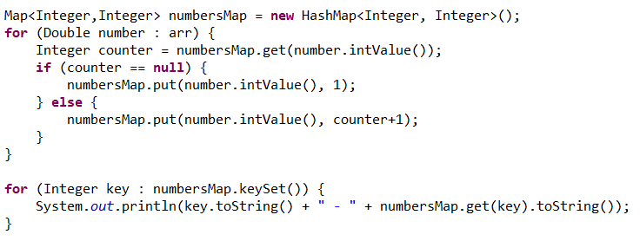
Collections and Iterator
Ex: Create a collection of double items and insert these numbers: 10.5, 6, 8, 4.5, 5,12.25, 8, 4, 6.3, 5
Count how many times a Integer number appears (4 – 2, 10 – 1):

Slide 35
Collections and Iterator
Ex: Create a collection of double items and insert these numbers: 10.5, 6, 8, 4.5, 5,12.25, 8, 4, 6.3, 5
Count how many times a Integer number appears (4 – 2, 10 – 1):

Slide 36
Overview
Exceptions
Collections interfaces
Iterators

Slide 37
Next session
Generics
Session
4

Slide 38

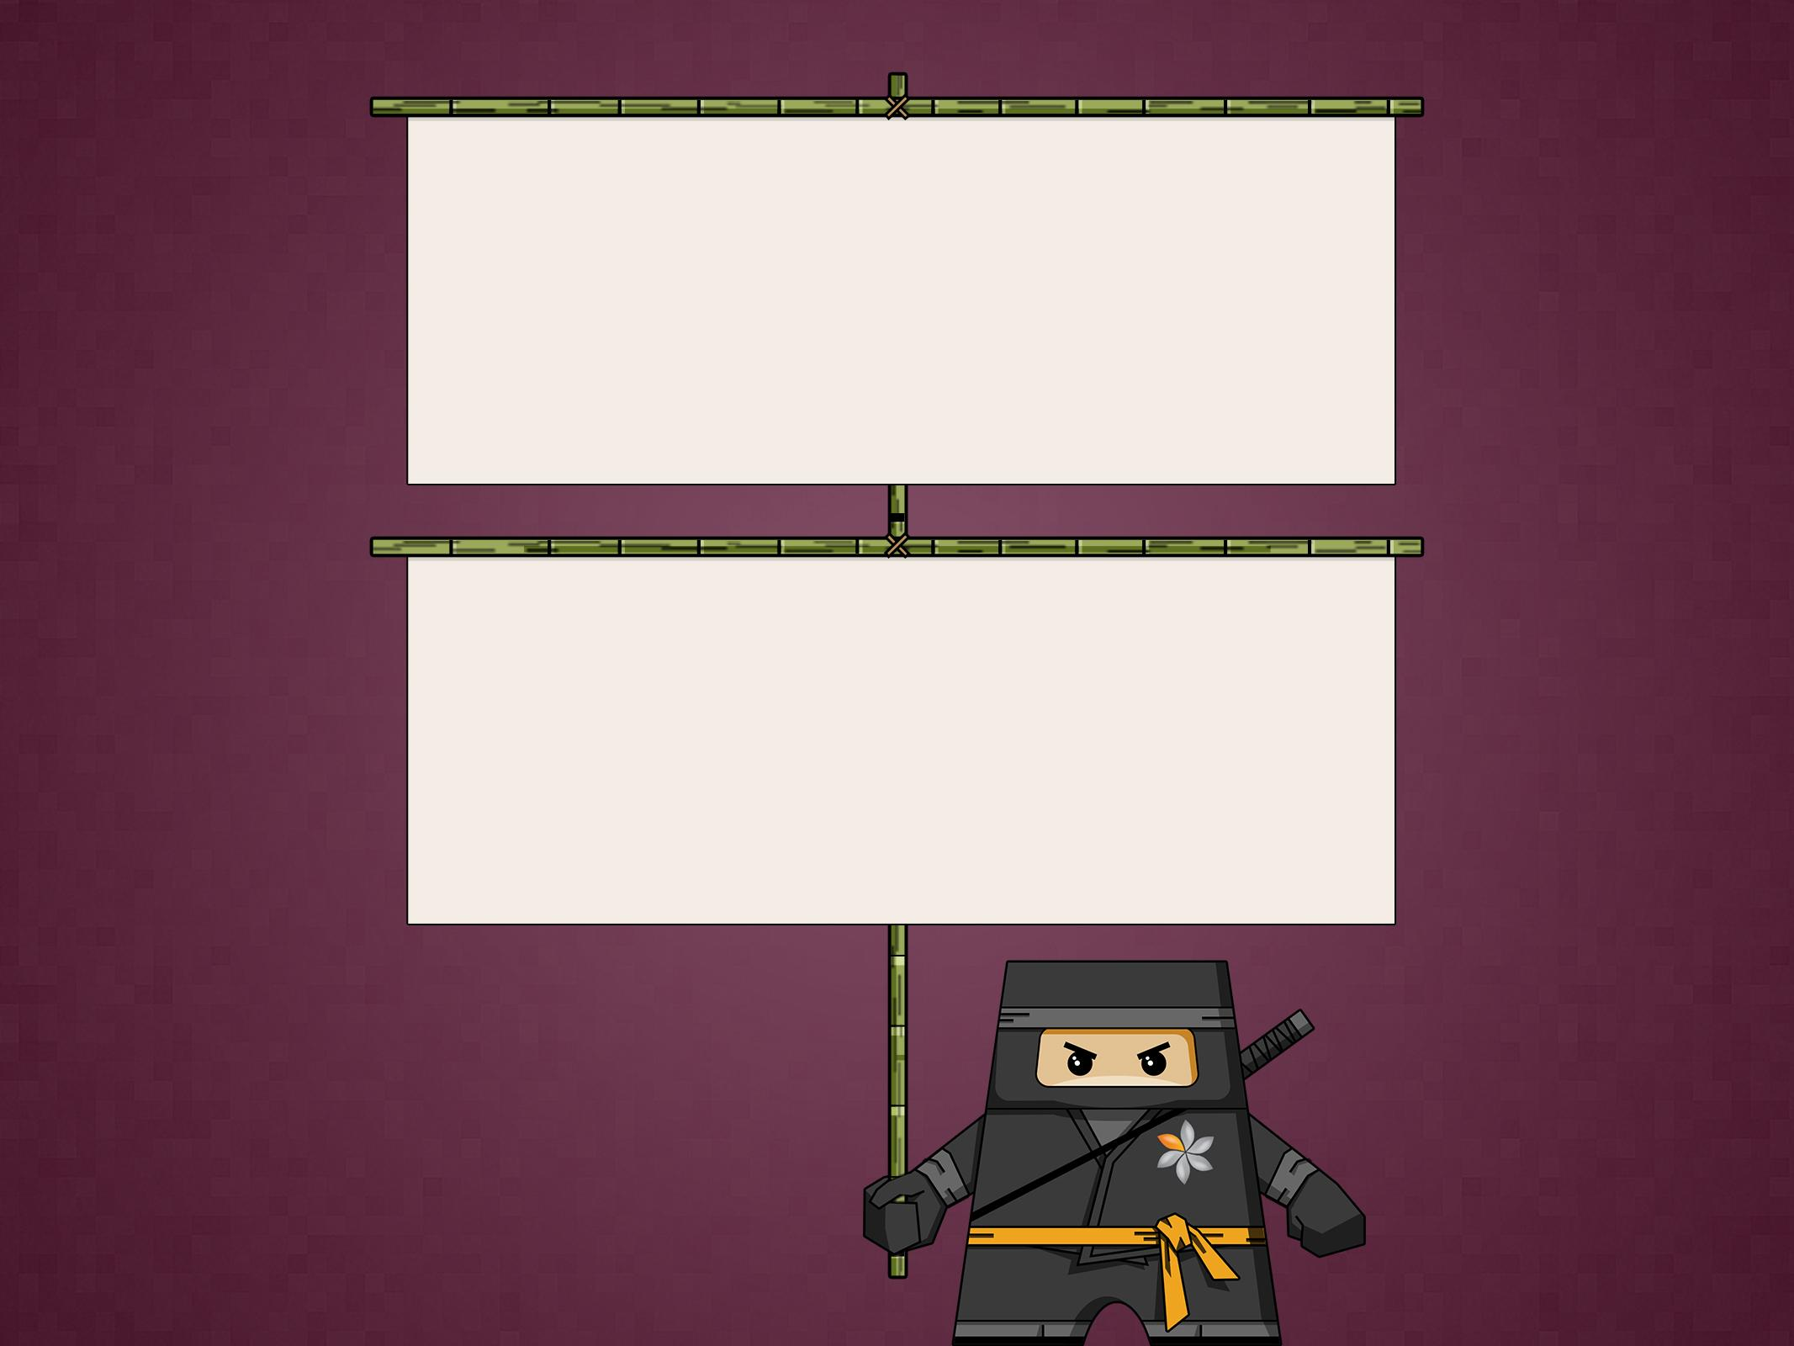
THANK YOU
Ido Barash
Email: ido.barash@tikalk.com

